Slide 1

Algebra 1
Unit 1, Lesson 4 Applying the Laws of Exponents Volume 1, pg. 22

Slide 2


Benchmark
MA.912.NSO.1.1
Extend previous understanding of the Laws of Exponents to include rational exponents. Apply the Laws of Exponents to evaluate numerical expressions and generate equivalent numerical expressions involving rational exponents.
volume 1, pg. 22

Slide 3
Integrated Mathematical Thinking and Reasoning Standards
MA.K12.MTR.2.1 Demonstrate understanding by representing problems in multiple ways.
MA.K12.MTR.3.1 Complete tasks with mathematical fluency.
MA.K12.MTR.4.1 Engage in discussions that reflect on the mathematical thinking of self and others.
MA.K12.MTR.5.1 Use patterns and structure to help understand and connect mathematical concepts.
volume 1, pg. 22

Slide 4

Learning Targets
I can apply the Laws of Exponents to write equivalent numerical expressions.
I can evaluate square roots and cube roots.
volume 1, pg. 22

Slide 5

Warm-Up
volume 1, pg. 23

Slide 6
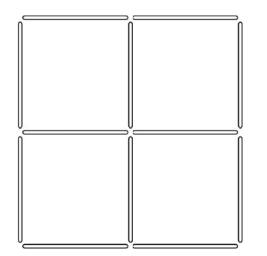
1.4.1 Warm-Up: Toothpick Squares
Make two squares of different sizes by removing two toothpicks.
volume 1, pg. 23
Notes:
Video Link: https://algebranation.wistia.com/medias/fi4fidi5y8

Slide 7

Refresher
volume 1, pg. 23

Slide 8

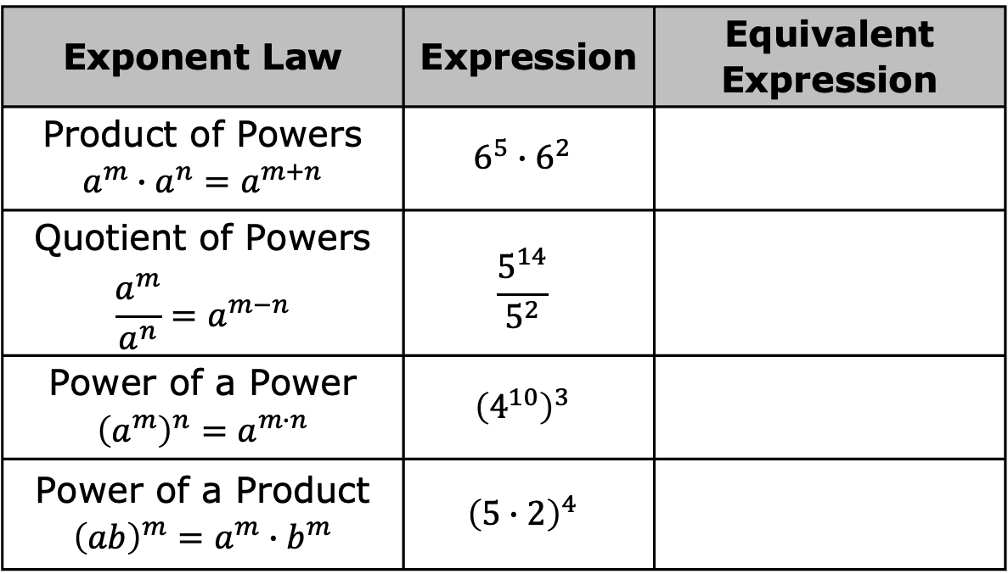
1.4.2 Refresher: Laws of Exponents
Using the given exponent law, complete the table by writing an equivalent exponential expression.
Exponent Law | Expression | Equivalent Expression
Product of Powers $$a^{m}∙a^{n}=a^{m+n}$$ | $$6^{5}∙6^{2}$$
Quotient of Powers $$\frac{a^{m}}{a^{n}}=a^{m−n}$$ | $$\frac{5^{14}}{5^{2}}$$
Power of a Power $${\left(a^{m}\right)}^{n}=a^{m∙n}$$ | $${\left(4^{10}\right)}^{3}$$
Power of a Product $${\left(ab\right)}^{m}=a^{m}∙b^{m}$$ | $${\left(5∙2\right)}^{4}$$
volume 1, pg. 23

Slide 9
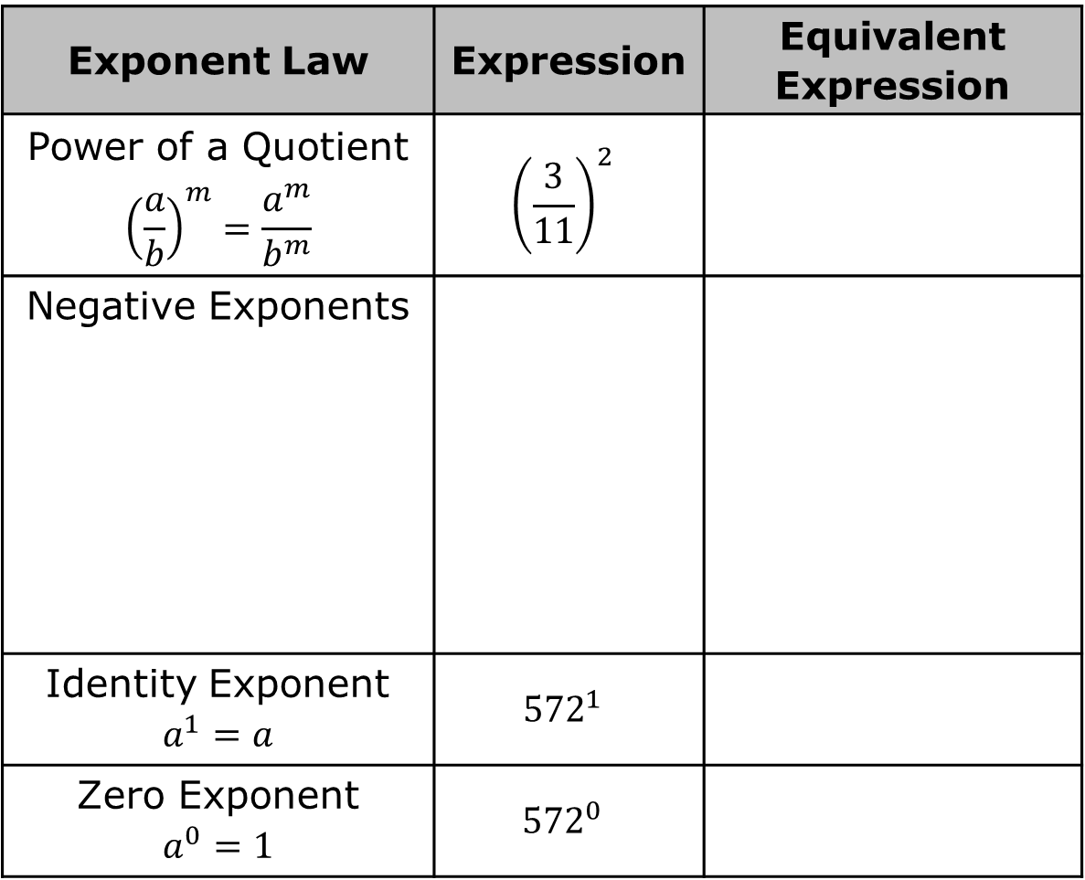
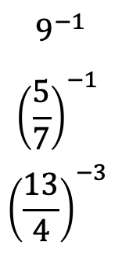
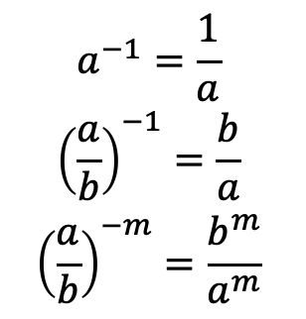
Exponent Law | Expression | Equivalent Expression
Power of a Quotient $${\left(\frac{a}{b}\right)}^{m}=\frac{a^{m}}{b^{m}}$$ | $${\left(\frac{3}{11}\right)}^{2}$$
Negative Exponents
Identity Exponent $$a^{1}=a$$ | $${572}^{1}$$
Zero Exponent $$a^{0}=1$$ | $${572}^{0}$$
$$9^{−1}$$
$${\left(\frac{5}{7}\right)}^{−1}$$
$${\left(\frac{13}{4}\right)}^{−3}$$
$$a^{−1}=\frac{1}{a}$$
$${\left(\frac{a}{b}\right)}^{−1}=\frac{b}{a}$$
$${\left(\frac{a}{b}\right)}^{−m}=\frac{b^{m}}{a^{m}}$$
volume 1, pg. 23

Slide 10

Guided Instruction
volume 1, pg. 24

Slide 11

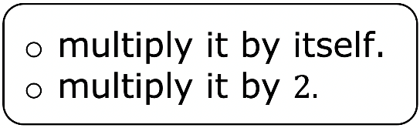

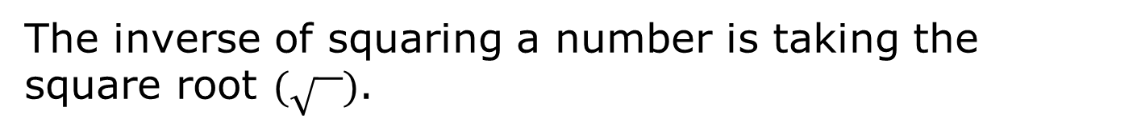

1.4.3 Guided Instruction: Building On Square Roots and Cube Roots
To square a number means to
$$7^{2}=______∙______=_______$$
$${\left(−7\right)}^{2}=______∙______=_______$$
The inverse of squaring a number is taking the square root $(\sqrt{ })$.
volume 1, pg. 24

Slide 12

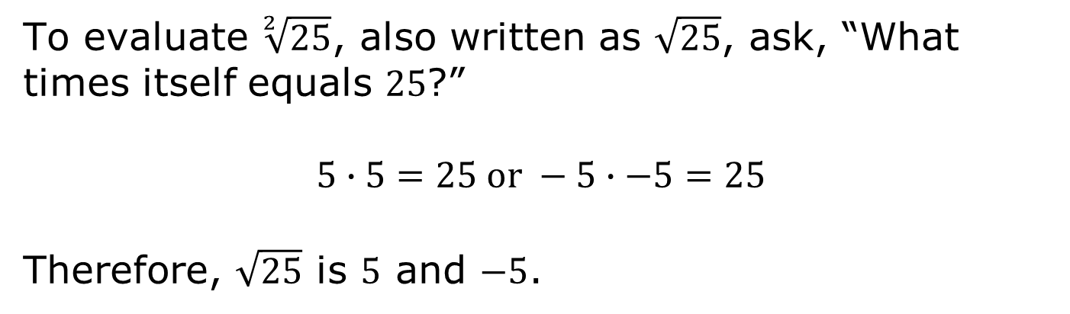
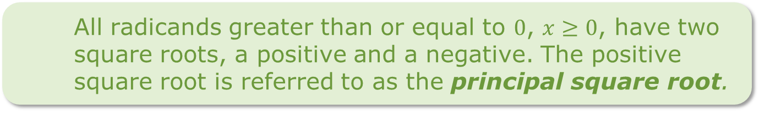
To evaluate $\sqrt[2]{25}$, also written as $\sqrt{25}$, ask, “What times itself equals $25$?”
$$5∙5=25 or −5∙−5=25$$
Therefore, $\sqrt{25}$ is $5$ and $−5$.
All radicands greater than or equal to $0$, $x≥0$, have two square roots, a positive and a negative. The positive square root is referred to as the principal square root.
volume 1, pg. 24

Slide 13
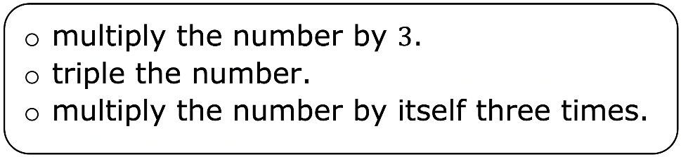
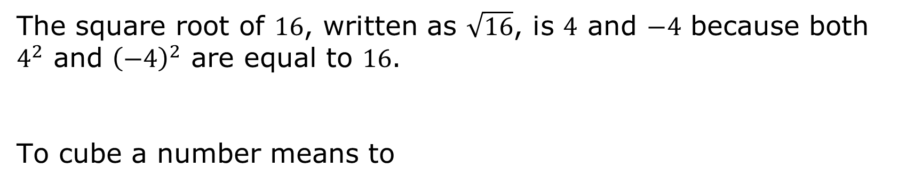
The square root of $16$, written as $\sqrt{16}$, is $4$ and $−4$ because both $4^{2}$ and ${\left(−4\right)}^{2}$ are equal to $16$.
To cube a number means to
$$6^{3}=$$ | $${\left(−6\right)}^{3}=$$
volume 1, pg. 24

Slide 14
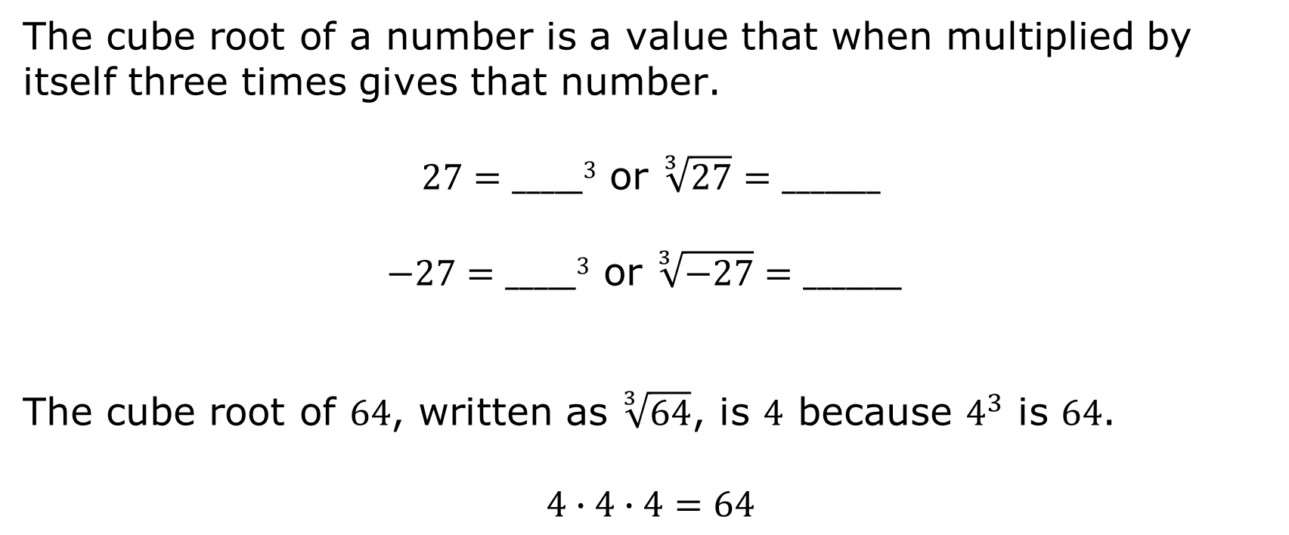
The cube root of a number is a value that when multiplied by itself three times gives that number.
$27=_____3$ or $\sqrt[3]{27}=_______$
$$−27=_____3 \text{or} \sqrt[3]{−27}=_______$$
The cube root of $64$, written as $\sqrt[3]{64}$, is $4$ because $4^{3}$ is $64$.
$$4∙4∙4=64$$
volume 1, pg. 24

Slide 15

Your Turn
volume 1, pg. 25

Slide 16

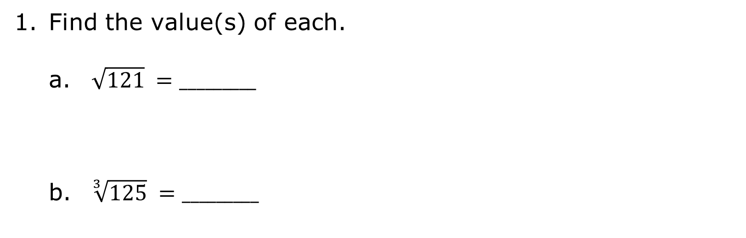
1.4.4 Your Turn!
Find the value(s) of each.
$\sqrt{121} =_________$
$\sqrt[3]{125} =_________$
volume 1, pg. 25

Slide 17
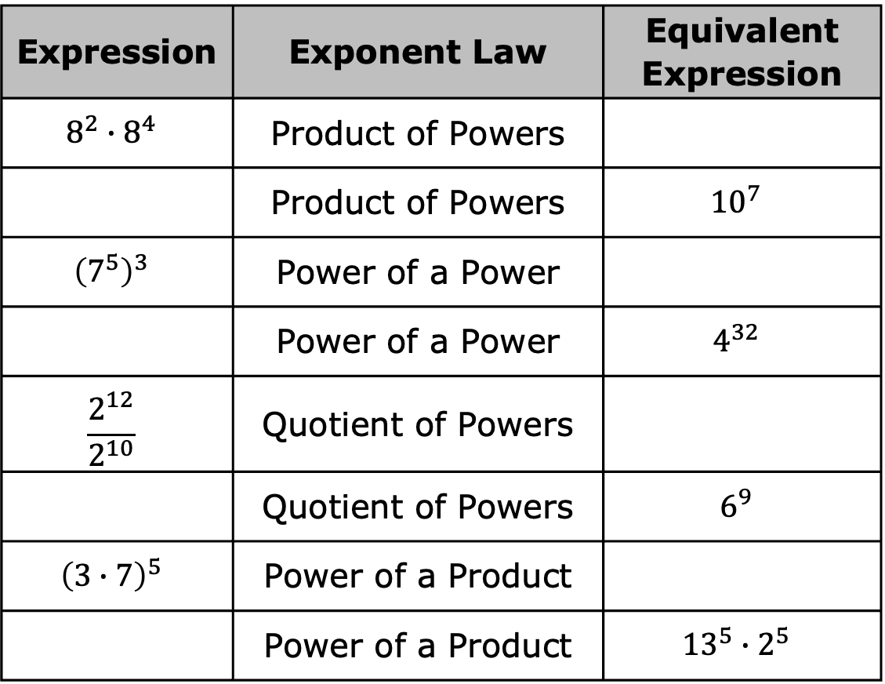
Work with a partner to complete the chart.
Expression | Exponent Law | Equivalent Expression
$$8^{2}∙8^{4}$$ | Product of Powers
 | Product of Powers | $${10}^{7}$$
$${\left(7^{5}\right)}^{3}$$ | Power of a Power
 | Power of a Power | $$4^{32}$$
$$\frac{2^{12}}{2^{10}}$$ | Quotient of Powers
 | Quotient of Powers | $$6^{9}$$
$${\left(3∙7\right)}^{5}$$ | Power of a Product
 | Power of a Product | $${13}^{5}∙2^{5}$$
volume 1, pg. 25

Slide 18
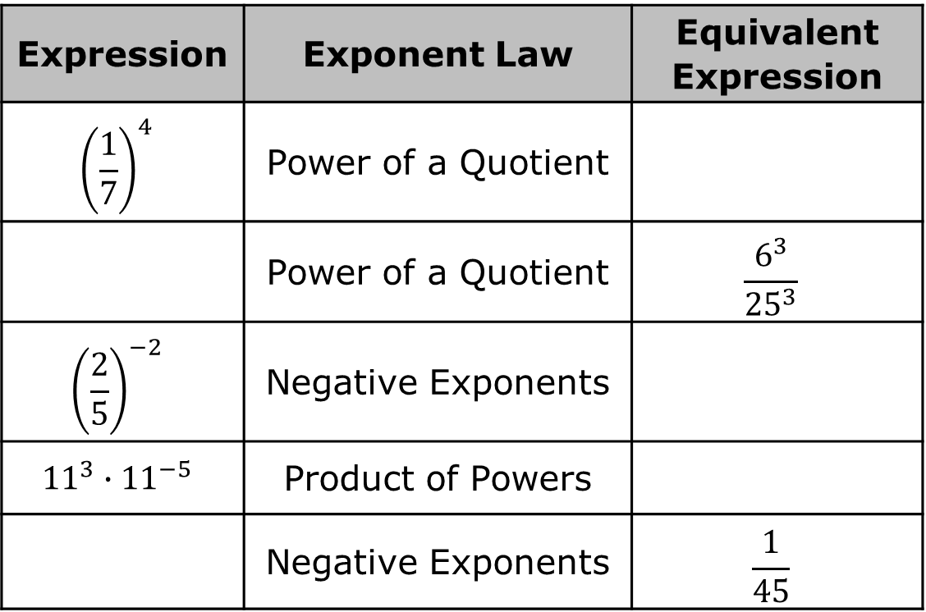
Expression | Exponent Law | Equivalent Expression
$${\left(\frac{1}{7}\right)}^{4}$$ | Power of a Quotient
 | Power of a Quotient | $$\frac{6^{3}}{{25}^{3}}$$
$${\left(\frac{2}{5}\right)}^{−2}$$ | Negative Exponents
$${11}^{3}∙{11}^{−5}$$ | Product of Powers
 | Negative Exponents | $$\frac{1}{45}$$
volume 1, pg. 25

Slide 19
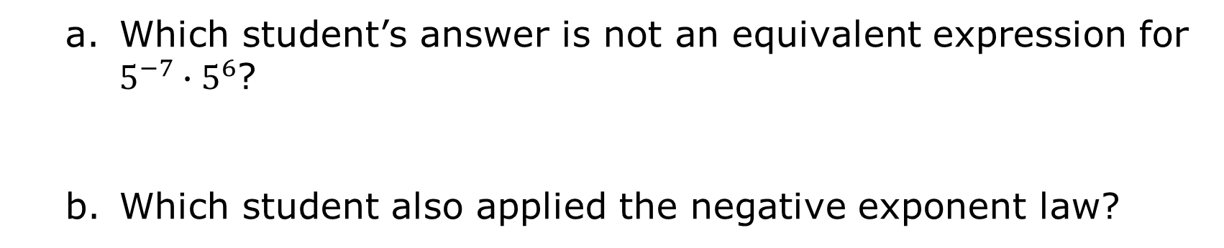
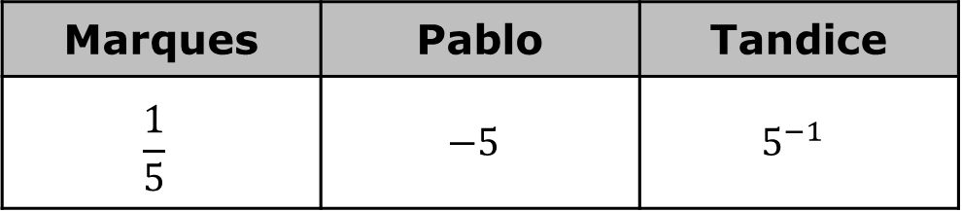
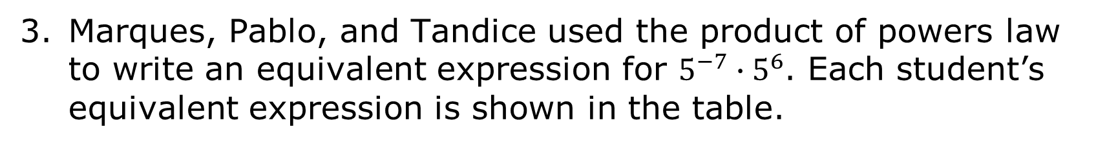
Marques, Pablo, and Tandice used the product of powers law to write an equivalent expression for $5^{−7}∙5^{6}$. Each student’s equivalent expression is shown in the table.
Marques | Pablo | Tandice
$$\frac{1}{5}$$ | $$−5$$ | $$5^{−1}$$
Which student’s answer is not an equivalent expression for $5^{−7}∙5^{6}$?
Which student also applied the negative exponent law?
volume 1, pg. 25

Slide 20
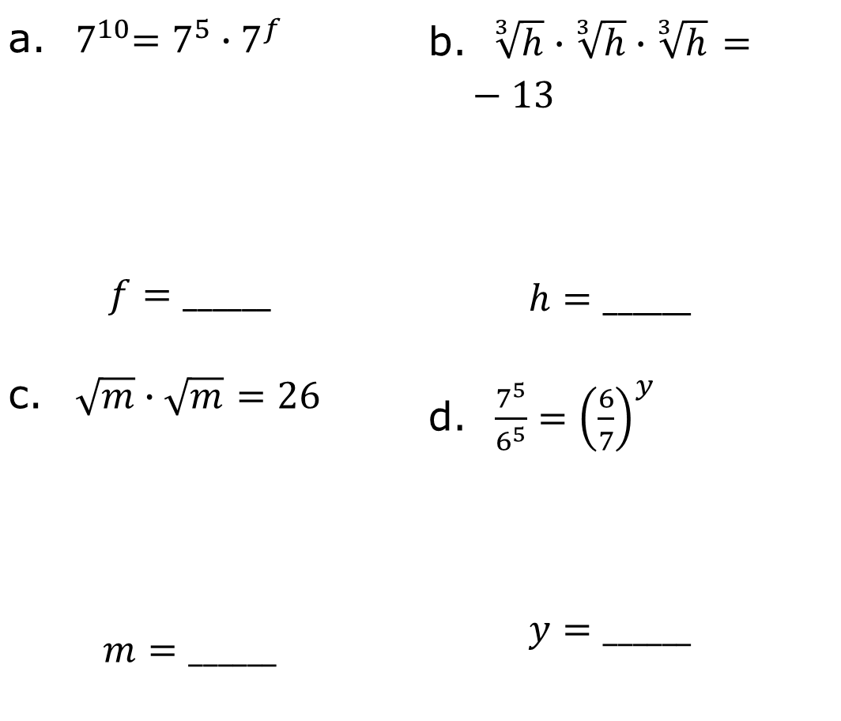
Find the value of the variable(s) that makes the equation true.
${ 7}^{10}=7^{5}∙7^{f}$ $$f=______$$ | $\sqrt[ 3]{h}∙\sqrt[3]{h}∙\sqrt[3]{h}$ $=−13$ $$h=______$$
$\sqrt{m}∙\sqrt{m}$ $=26$ $$m=______$$ | $\frac{7^{5}}{6^{5}}={\left(\frac{6}{7}\right)}^{y}$ $$y=______$$
volume 1, pg. 26

Slide 21
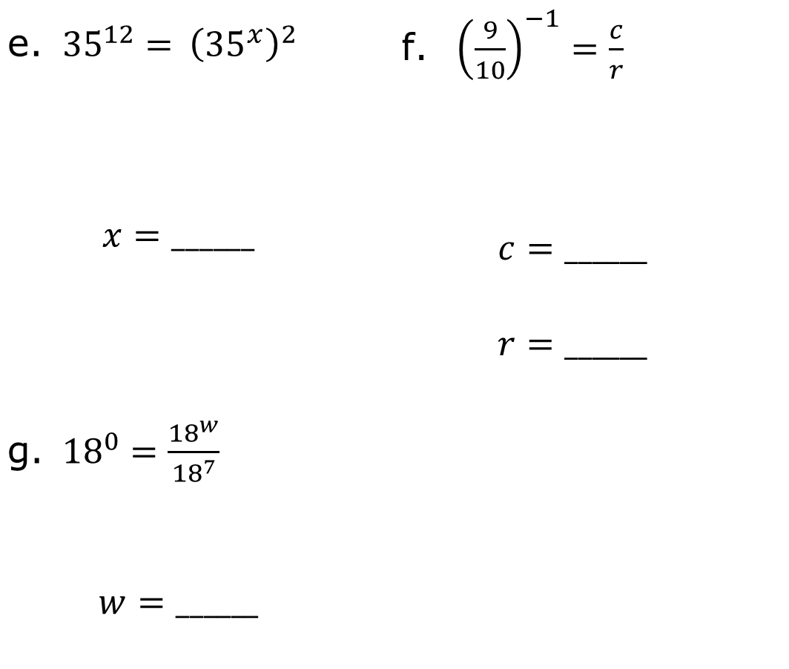
${35}^{12}={ \left({35}^{x}\right)}^{2}$ $$x=______$$ | ${\left(\frac{9}{10}\right)}^{−1}=\frac{c}{r}$ $$c=______$$ $$r=______$$
${18}^{0}=\frac{{18}^{w}}{{18}^{7}}$ $$w=______$$
volume 1, pg. 26

Slide 22

Wrap-Up
volume 1, pg. 26

Slide 23
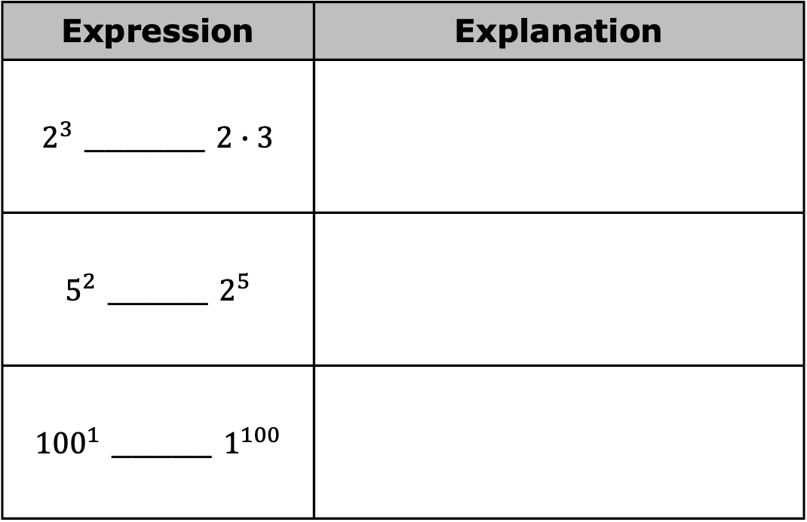
1.4.5 Wrap-Up: Cool Down
Use the symbols $<$, $>$, or $=$ to compare each pair of values. Then, explain your choice.
Expression | Explanation
$2^{3}$ ______ $2∙3$
$5^{2}$ _____ $2^{5}$
${100}^{1}$ _____ $1^{100}$
volume 1, pg. 26

